Slide 1





CONSUMER GOODS
Ad-hoc insights
Presented by Harini

Slide 2
Overview:
Problem Statement:
Approach
Atliq Hardwares, a leading computer hardware producer in India, seeks to improve its data analytics for better decision-making.
The management identified a need for more actionable insights to support swift and informed decisions. Tony Sharma, Director of Data Analytics, aimed to hire skilled junior analysts through a SQL challenge addressing 10 specific business queries
Reviewed the ‘ad-hoc-requests.pdf’ document containing 10 specific business queries requiring insights.
Developed and executed SQL queries to extract relevant data and provide answers to each of the ad hoc requests.

Slide 3
DATASET
DATABASE
gdb023
TABLES
dim_customer
dim_product
Fact_gross_price
Fact_sales_monthly
Fact_manufacturing_cost
Fact_pre_invoice_reducion

Slide 4
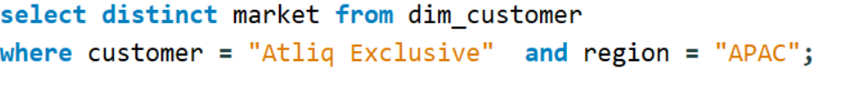

1. Provide the list of markets in which customer "Atliq Exclusive" operates its business in the APAC region.
Output:
Insights
In the Asia Pacific Region, “Atliq Exclusive” operates in 8 countries

Slide 5
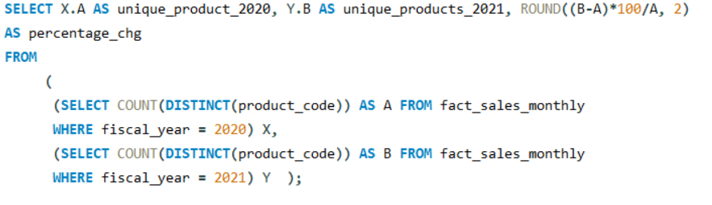

2. What is the percentage of unique product increase in 2021 vs. 2020? The final output contains these fields,
Insights
There was a significant increase in unique products, with 334 in 2021 compared to 245 in 2020. marking a substantial growth rate of 36.33%
Output:

Slide 6
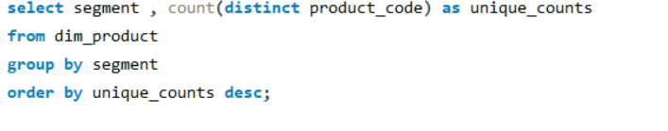
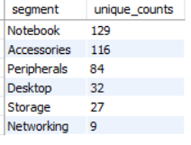
3. Provide a report with all the unique product counts for each segment and sort them in descending order of product counts. The final output contains 2 fields, segment and product_count
Insights
Output:
The "Notebook" segment has the highest product count, with 129 products.
The "Networking" segment has the smallest product count with only 9 products.

Slide 7
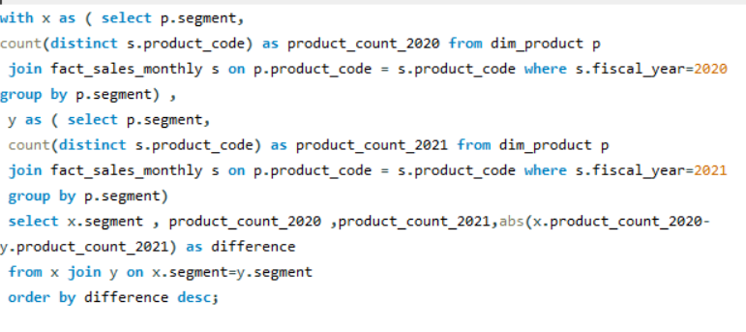
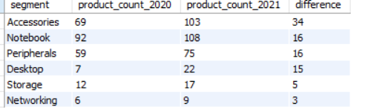
4. Which segment had the most increase in unique products in 2021 vs 2020? The final output contains these fields, segment, product_count_2020, product_count_2021 difference
Insights
Output:
The Accessories segment has introduced 34 new unique products in the year 2021.

Slide 8
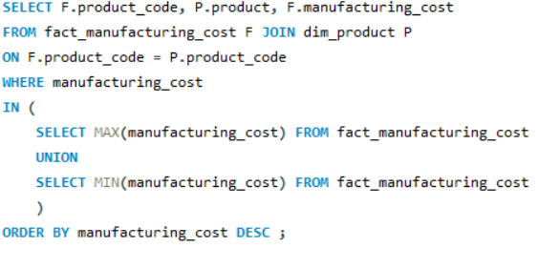

5. Get the products that have the highest and lowest manufacturing costs. The final output should contain these fields: product_code, product, manufacturing_cos
Insights
The product “AQ HOME All in 1 Gen 2” has the highest manufacturing cost.
The product “AQ Master Wired x1 MS” has the lowest manufacturing cost.
Output:

Slide 9
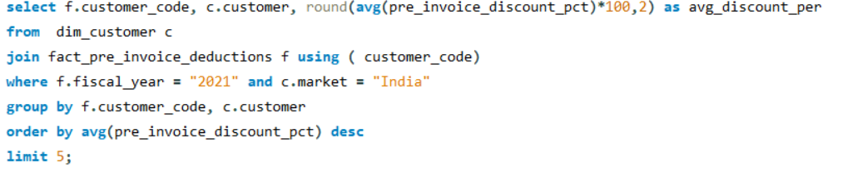
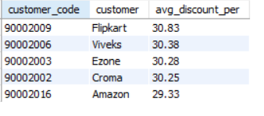
6. Generate a report which contains the top 5 customers who received an average high pre_invoice_discount_pct for the fiscal year 2021 and in the Indian market. The final output contains these fields: customer_code, customer, average_discount_percentage.
Output:
Insights
Flipkart has the highest average discount percentage of 30.83 %.
Amazon with the lowest average discount percentage of 29.33 %.

Slide 10
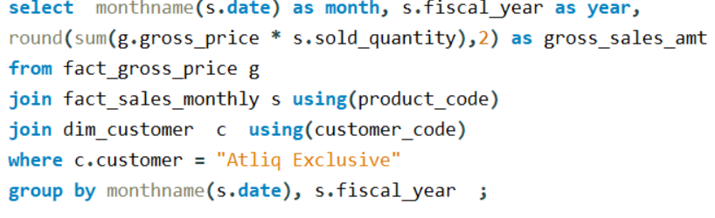
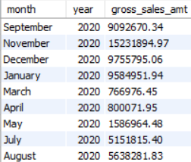
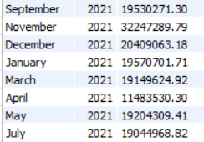
Get the complete report of the Gross sales amount for the customer “Atliq Exclusive” for each month. This analysis helps to get an idea of low and high-performing months and take strategic decisions.
The final report contains these columns: Month, Year, Gross sales Amount.
Output:
Insights
The lowest Gross sales total for both fiscal years is in March(2020).
The highest Gross sales total for both fiscal years is in November (2020)

Slide 11
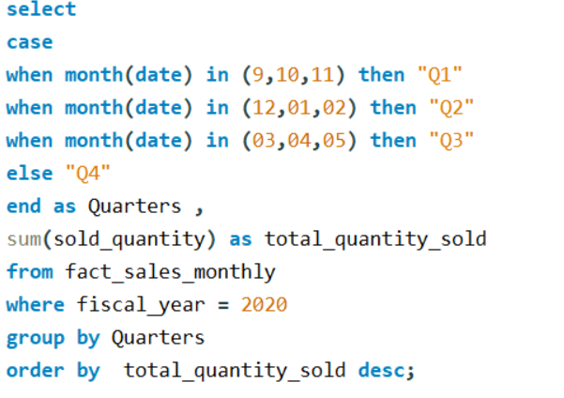
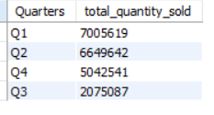
8. In which quarter of 2020, got the maximum total_sold_quantity? The final output contains these fields sorted by the total_sold_quantity, Quarter total_sold_quantity
Insights
Output:
The highest total sold quantity is in Q1 with 7,005,619 units.

Slide 12
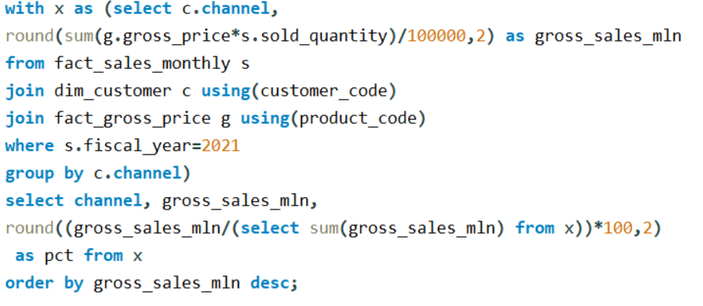
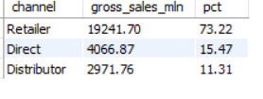
9. Which channel helped to bring more gross sales in the fiscal year 2021 and the percentage of contribution? The final output contains these fields: channel, gross_sales_mln, percentage.
Insights
Output:
The "Retailer" channel has contributed the highest of about 73.22% of gross sales.

Slide 13
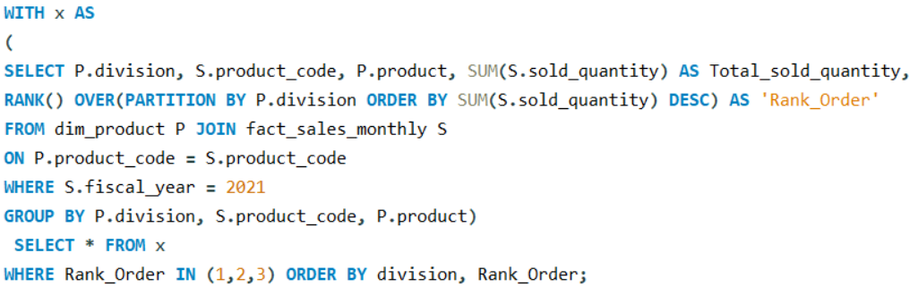
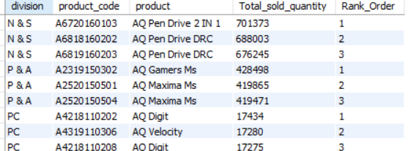
10. Get the Top 3 products in each division that have a high total_sold_quantity in the fiscal_year 2021? The final output contains these fields: division, product_code, product, total_sold_quantity, rank_order
Insights
The top 3 selling products in N&S were pen drives, which were around 7 lakh in quantity.
The top 3 selling products in P&A were mouse, which were around 4 lakh in quantity.
The top 3 selling products in PC were personal laptops, which were around 17000 in quantity
Output:

Slide 14
RESUME PROJECT
CHANLLENGE # 4
THANK YOU
Presented by Harini

